Slide 1





Shri Vishnu Engineering College For Women
(Autonomous)
Department Of Computer Science Engineering
Real-Time
Spam Detection
on Telegram
Presented By:
22B01A0573
22B01A0586
22B01A05B3
23B05A0511
Guided By:
Mr. P.Naga Raju

Slide 2

ABSTRACT
This project aims to develop an automated Spam Detection System for Telegram groups using Python. With the rising abuse of Telegram by spammers to spread phishing links, fake job offers, investment scams, and promotional messages, there is a strong need for tools that can monitor and moderate group chats in real time.
The proposed system uses the python-telegram-bot library to detect spam based on predefined keywords, suspicious link patterns, and message frequency (flooding). Once a message is identified as spam, it is immediately deleted, and the user may be temporarily muted if necessary. The system also intelligently checks user roles to avoid acting on admins or group owners.

Slide 3
ABSTRACT
All detected spam messages and actions taken are securely logged into a MySQL database, allowing for future analysis and transparency. This approach ensures effective content moderation and helps prevent group disruption caused by malicious users.
By combining real-time detection, automation, and reliable logging, this project enhances safety in Telegram communities and offers a lightweight yet powerful solution for group administrators.

Slide 4
TECHNOLOGIES
Programming Language : Python
Database : MySql

Slide 5
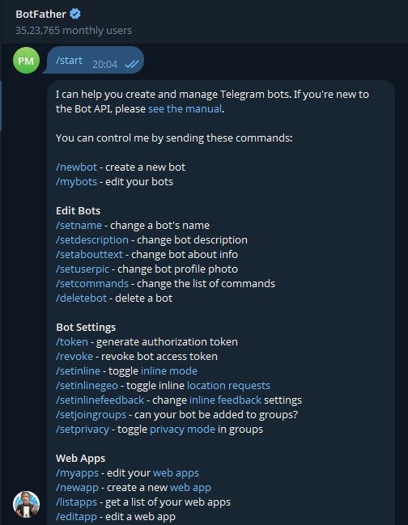
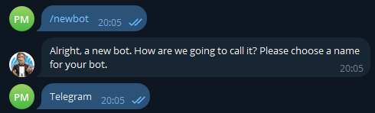

Real-life scenarios

Slide 6
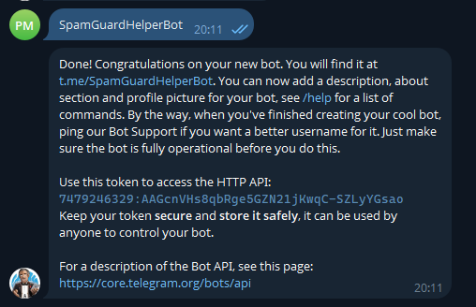
Real-life scenarios

Slide 7
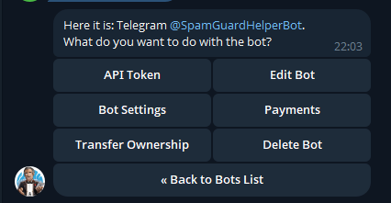
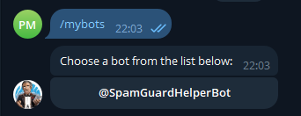
Real-life scenarios

Slide 8
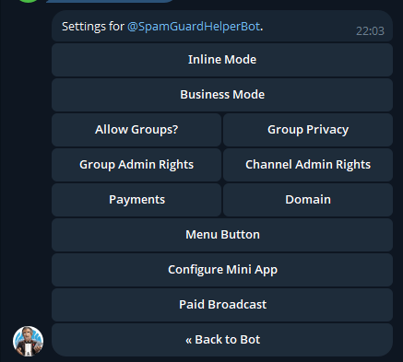
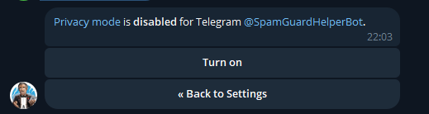
Real-life scenarios

Slide 9


Real-life scenarios
For Admins:

Slide 10

Real-life scenarios
For Non-Admin Users:

Slide 11
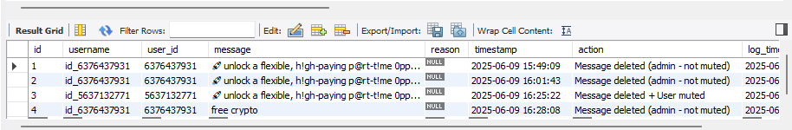
Database Storage

Slide 12
Advantages
Real-Time Protection The bot automatically monitors and moderates group chats, preventing spam, scam messages, and malicious links in real time.
Reduces Admin Burden Group administrators no longer need to manually monitor every message, as the bot automates spam detection and action.
Customizable Filters Spam keywords and patterns can be easily updated or extended to adapt to new scam techniques.

Slide 13
Database Logging Actions (like message deletions, user mutes) are logged in a MySQL database, which helps in tracking spam trends and reporting.
Simple Deployment Runs without a web interface, making it easier to deploy for users who don’t want to host a web server.
Lightweight Doesn’t require large resources or dependencies like Flask or Django, so it can run on basic systems or cloud instances.

Slide 14
Disadvantages
No Web Interface Without Flask or any frontend, administrators must access logs manually via the database, which is not user-friendly.
Limited Spam Detection Intelligence Relies on keyword matching and link patterns. It may not catch advanced or cleverly disguised spam (e.g., with Unicode obfuscation).
False Positives/Negatives Legitimate messages may get flagged or spam might go undetected if not properly filtered.

Slide 15
Existing Work
Combot Anti-Spam
Uses a BotFather-created bot.
Provides auto-moderation and spam detection in real time.
Has admin tools and statistical dashboards.
Shieldy Bot
Created using BotFather, allows auto-kicking or muting of users who don't respond to CAPTCHA.
Useful against join-and-spam bots.
Miss Rose Bot
A very popular moderation bot created using BotFather.
Offers anti-spam, anti-flood, word bans, and more.

Slide 16
References
Alansari, M.M.H., Aljazzaf, Z.M. and Sarfraz, M. (2019). On Cyber Crimes and Cyber Security. Developments in Information Security and Cybernetic Wars, pp.1–41. doi:https://doi.org/10.4018/978-1-5225-8304-2.ch001.
Kashyap, S. (2017). Prevention of Cyber Crimes in India A Comparative Study. Inflibnet.ac.in. [online] doi:http://hdl.handle.net/10603/379851.
Anuraj Singh (2007), Volume 05, Issue 06, PP. 11273- 11279‌
‌
‌

Slide 17
Thank You

